Slide 1
Custard Fall
Pitch from June 12 2022
Led by JustGreg, releasing October 23 2022
Unity3D 2021.3.4f1

Slide 2
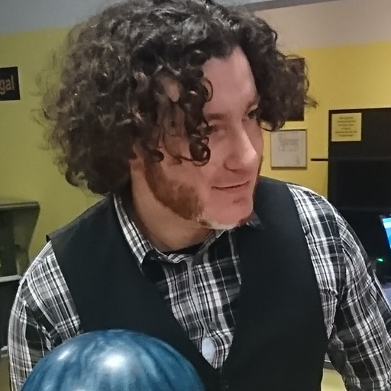
Meet Greg
(Grygoriy Kulesko)
HomeTeam member since 2020
Second time project lead
Three times game changer
Programmer by day but also enjoy 3d modelling, sound design and UX thinking

Slide 3
Ionic Defender
(2021, Project Lead)
Game design
Coding of core mechanics
SFX
3d environment
UX design

Slide 4
Also on
HomeTeam
Apollo
Eden-sky-tower - bug fixes

Slide 5
Also on
HomeTeam
Outpost
Pawsome-Space-Barge - coding, 3d art and sfx
Daggers-gate - first steps in pixel art
grimsnap - bug fixes
witches-and-guns - coding

Slide 6
The Many Types of Apocalypses
Survival in a post apocalyptic world:
Zombies? Lone man in dead town? Dystopian space tale? Mutants?

Slide 7
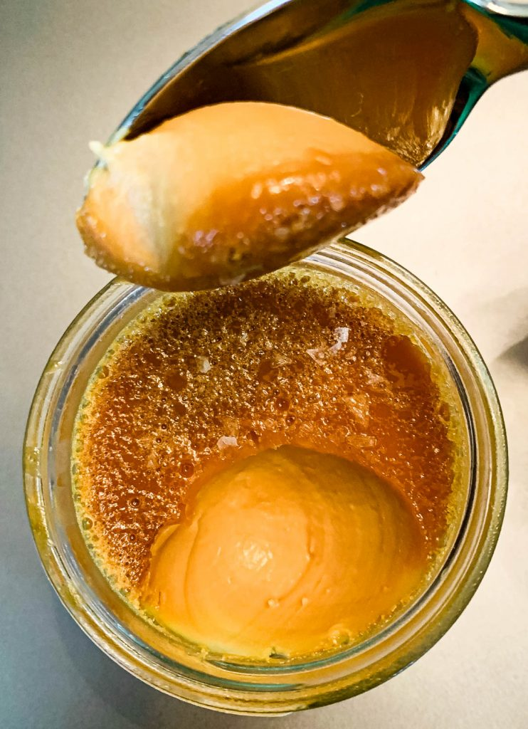
A Special Kind of Apocalypse
How about spicing things up with an unusual twist.
The the remains of the world as we know it are literally covered in food but it is all sweets and pastry. With a Mind of its own.

Slide 8
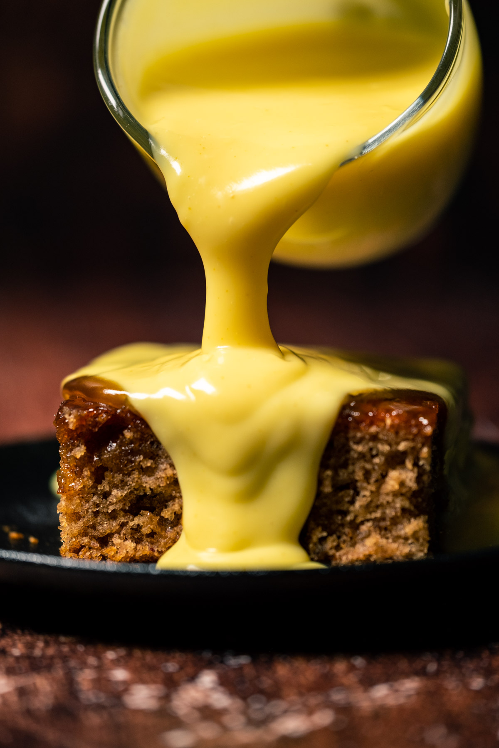
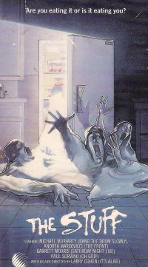
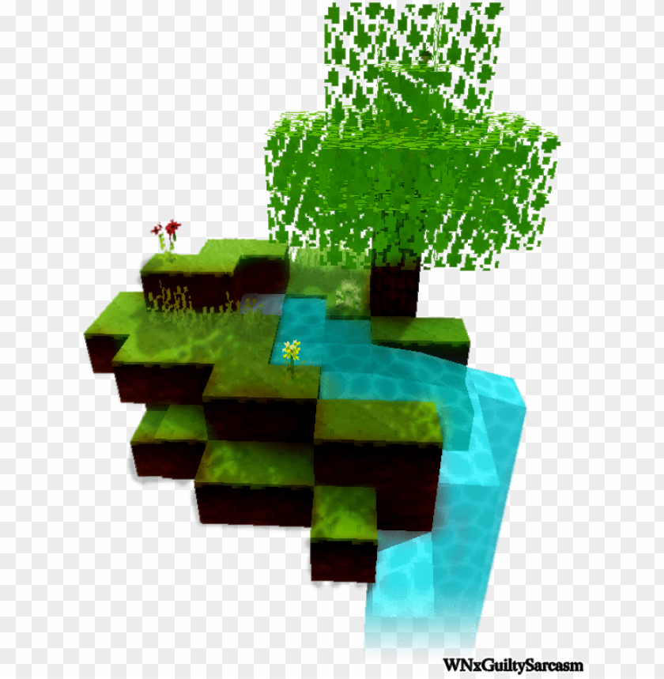
Custard Post-Apocalypse
Inspired by The Stuff (1985), Gray Goo, Nausicaä (Ghibli, 1984) and Minecraft
At the dawn of apocalypse there was custard rain. Mix of near future with remainings of the past buried under a scifi world with its own ecosystem.

Slide 9
Inspiration for gameplay
Kirby Games
Inhaling as a core game mechanic - gather resources and use for fighting creatures

Slide 10
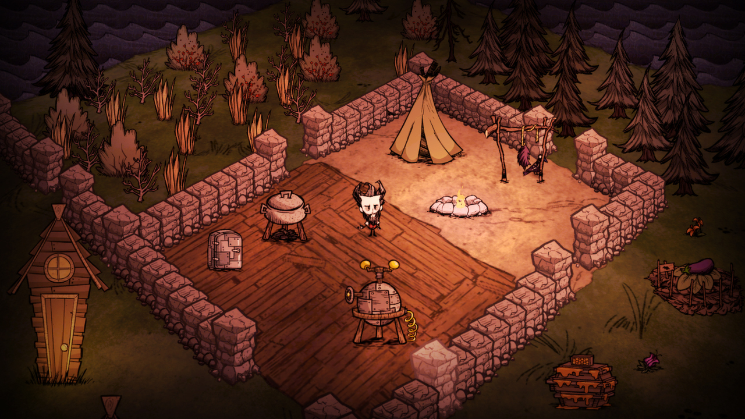
Inspiration for gameplay
Don’t Starve
Survive in a weird, hostile world by LOOTING and building structures that can help you keep alive

Slide 11
Demo Time!

Slide 12
Rough Roadmap
01
Inhale resources
05
Fighting static enemies
02
Kinematic Controller
06
Feedback Round
03
Crafting & Inventory
Target Platform
04
Food Items
PC, webGL with keyboard-mouse and gamepad controls

Slide 13
To the Trello!

Slide 14
Things you can do!
Programming
Game Design
3D Art
Music & Sound
player abilities, kinematic controller, custard ai, game HUD, crafting and inventory menus
experiment with small game worlds that are fun to survive in and that foster cool moments
environmental storytelling, expressive low-poly level design, player animation and a lot of items and structures
looping synth & electric guitar music, a lot of sfx for feedback and mood

Slide 15
Come join us in
#team-custard-fall

Slide 16
THANKS!
Do you have any questions?
youremail@freepik.com
+91 620 421 838
yourcompany.com
Please keep this slide for attribution

